Slide 1
Online course registration system (OCR)
Betina Driggers
CST 499 – Capstone for computer Software Technology
Dr. Charmelia Butler
October 17, 2025
Notes:
“Hello everyone, I’m Betina Driggers, and welcome to my final capstone project presentation for CST 499. Today I’ll walk you through my Online Course Registration System, developed with PHP and MySQL using the XAMPP stack.”

Slide 2
Project Overview
Goal: Develop a secure and scalable online course registration portal.
Technology Stack: PHP 8 and MySQL on XAMPP.
Components: Landing page, Login page, User Profile Registration page, User Profile page, Course API.
Approach: SRS Analysis to build a UML design that guided the database build, frontend integration, and backend integration.

Slide 3
Software requirements specification (SRS)
Functional Requirements: Registration, login, authentication, and course management.
Non-Functional Requirements: Maintainability, performance, scalability, security, and usability.
System Actors: Admin, staff, and students.
Dependencies: PHP, MySQL, Bootstrap, and AJAX.

Slide 4
UML Design Model
Use Case Diagram: Profile registration, user login, add/drop course, and view schedule.
Class Diagram: User, course, and enrollment entities with relationships.
Sequence Diagram: Registration flow that goes from the form to the process, then to the database, and finally to a commit.
Modular object-oriented PHP code structure.

Slide 5
Landing and login pages
Landing Page (Master.php): Bootstrap layout with necessary navigation links.
Login Page: User authentication utilizing hashed password verification.
Session Management: Validation via role-based access.
User Interface (UI) Principles: Responsive design with a clear navigation structure (Tsui et al., 2018).

Slide 6
Registration and Enrollment pages
Register.php: Frontend HTML form with Bootstrap styling and input validation.
Registration_Process.php: Server-side validation and data input using prepared statements (PHP, 2019).
Profile.php: Displays student data, course information, current course registrations (up to three semesters), current course waitlist, and course credit information.
AJAX integration updates enrollment/waitlist data without needing to reload the page.

Slide 7
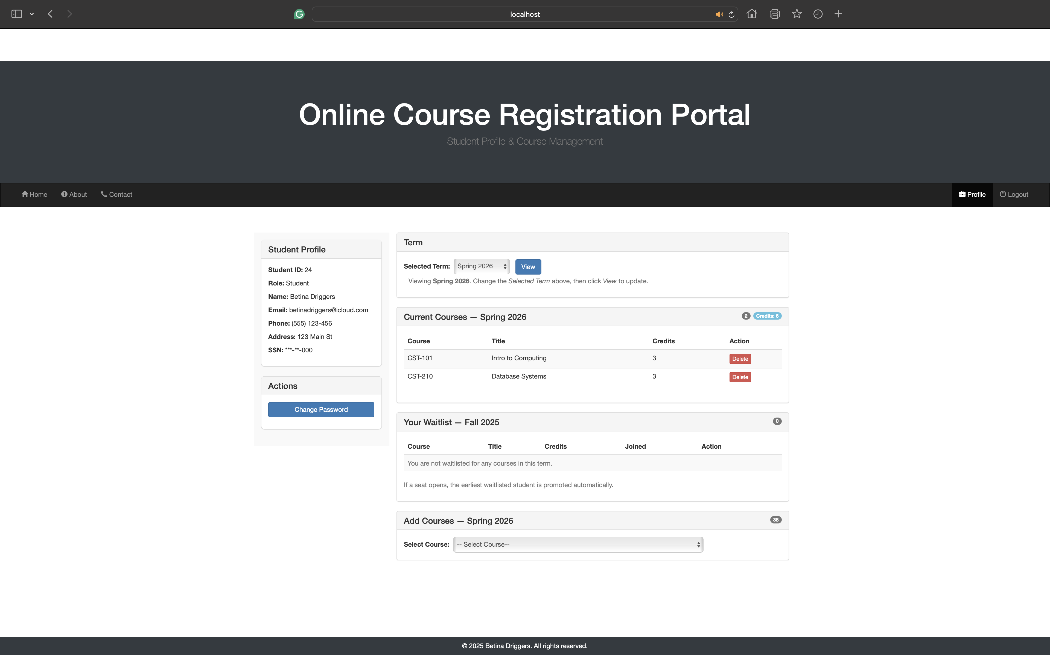
Profile Page Example

Slide 8
MySQL database design
Tables: tblUser, tblCourse, and tblEnrollment
Utilizes InnoDB with primary and foreign keys for integrity (Codd, 1970).
A normalized schema prevents data redundancy and anomalies.
SQL constraints manage course capacity and waitlist logic.

Slide 9
Database Integration and Security
CR_DB_Conn_Class.php: Centralized connection class for mysqli.
Uses prepared statements and error handling.
SQL injection is prevented by using parameter binding.
Utilizes secure coding practices.

Slide 10
Course API and ajax flows
Courses_API.php: JSON API that enables the Add, Drop, and Waitlist operations simultaneously.
Improves UI experience as page reloads are not utilized.
Highlights RESTful architecture principles (Tsui et al., 2018).

Slide 11
Key Lessons and Challenges
Importance of schema integrity and foreign keys (Codd, 1970).
Security through prepared statements (PHP, 2019).
Efficient simultaneous updates using AJAX (MySQL, 2019).
Emphasis on maintainability, scalability, and code readability Tsui et al., 2018).

Slide 12
Conclusion
The OCR system achieves secure registration and data management.
Combines UML, PHP, and MySQL to build a cohesive application.
Demonstrates software engineering principles that include maintainability, scalability, security, and usability.

Slide 13
Conclusion
The OCR system achieves secure registration and data management.
Combines UML, PHP, and MySQL to build a cohesive application.
Demonstrates software engineering principles that include maintainability, scalability, security, and usability.

